Slide 1
NAME | RUTHRAPRASATH K
REG NO | 311520205303
CLASS | B.Tech – IT – 4th year
EMAIL ID | prasathkaran1@gmail.com
 | ASSIGNMENT - 3
Task | Perform the three types of Visualization
Problem Statement:-
Tasks:-
1. Download the dataset: Dataset
2. Load the dataset.
3. Perform the Below Visualizations.
● Univariate Analysis
● Bi - Variate Analysis
● Multi-Variate Analysis
4. Perform descriptive statistics on the dataset.
5. Handle the Missing values.

Slide 2
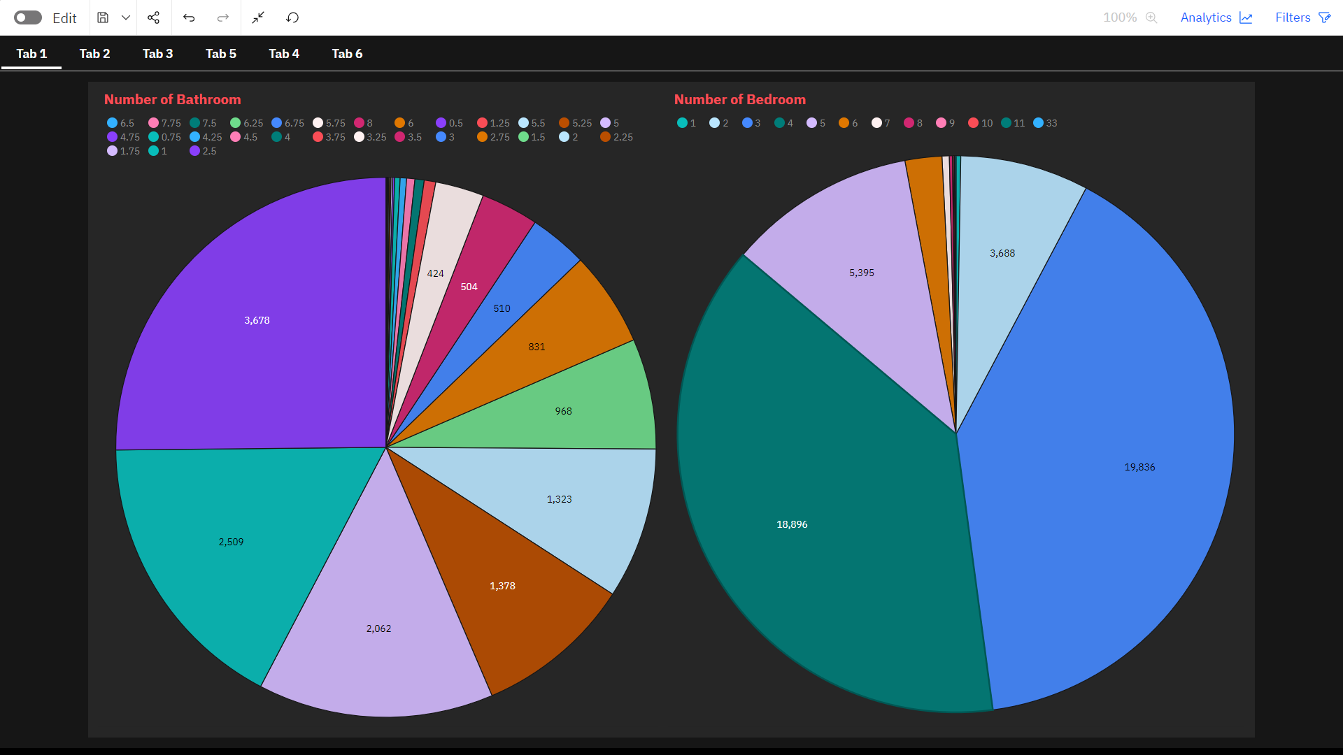
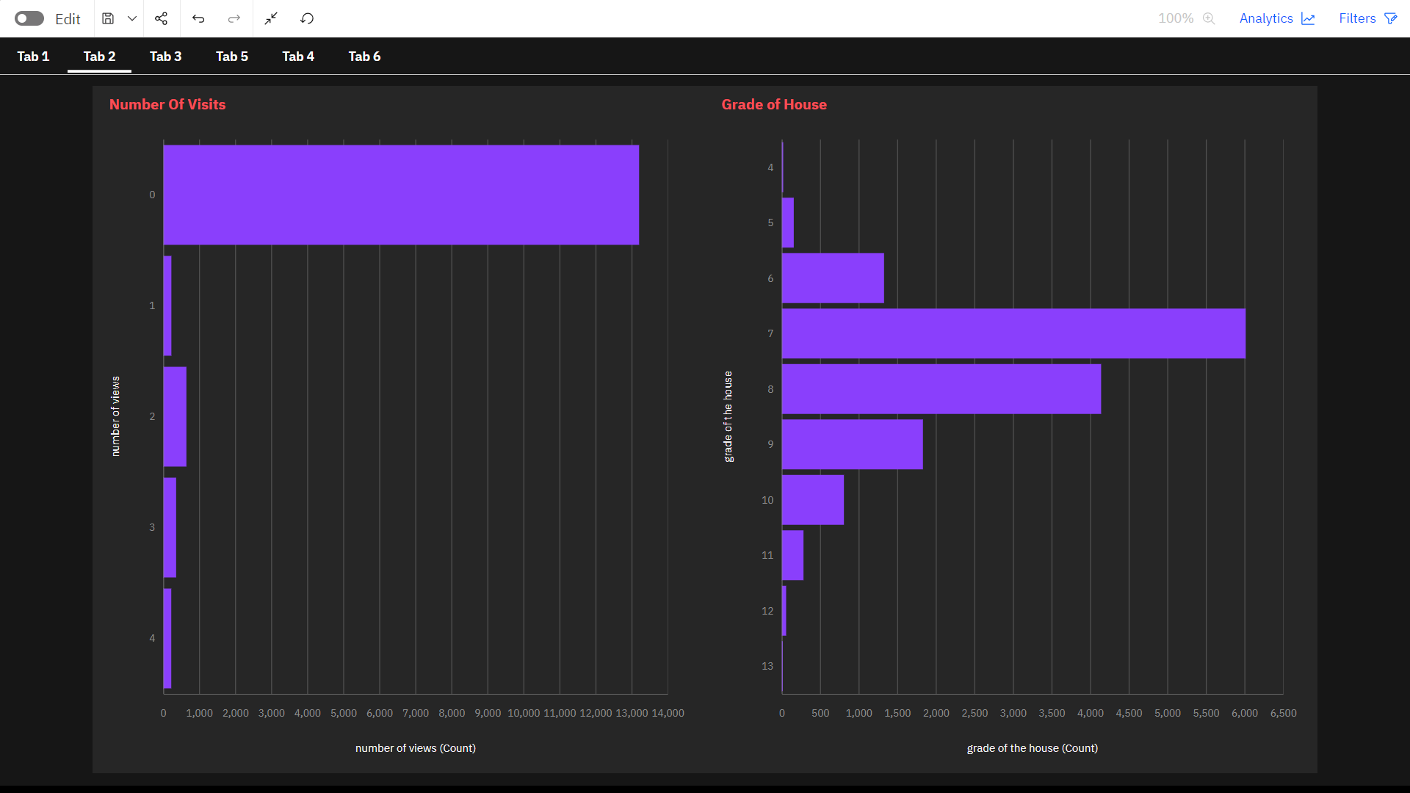
Univariate Analysis

Slide 3
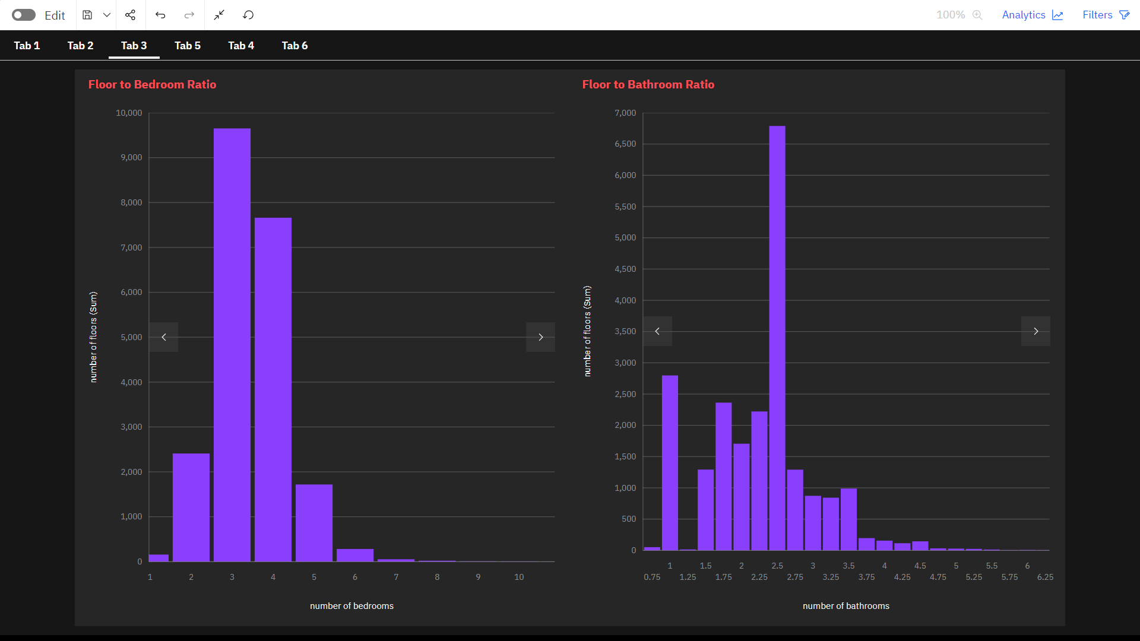
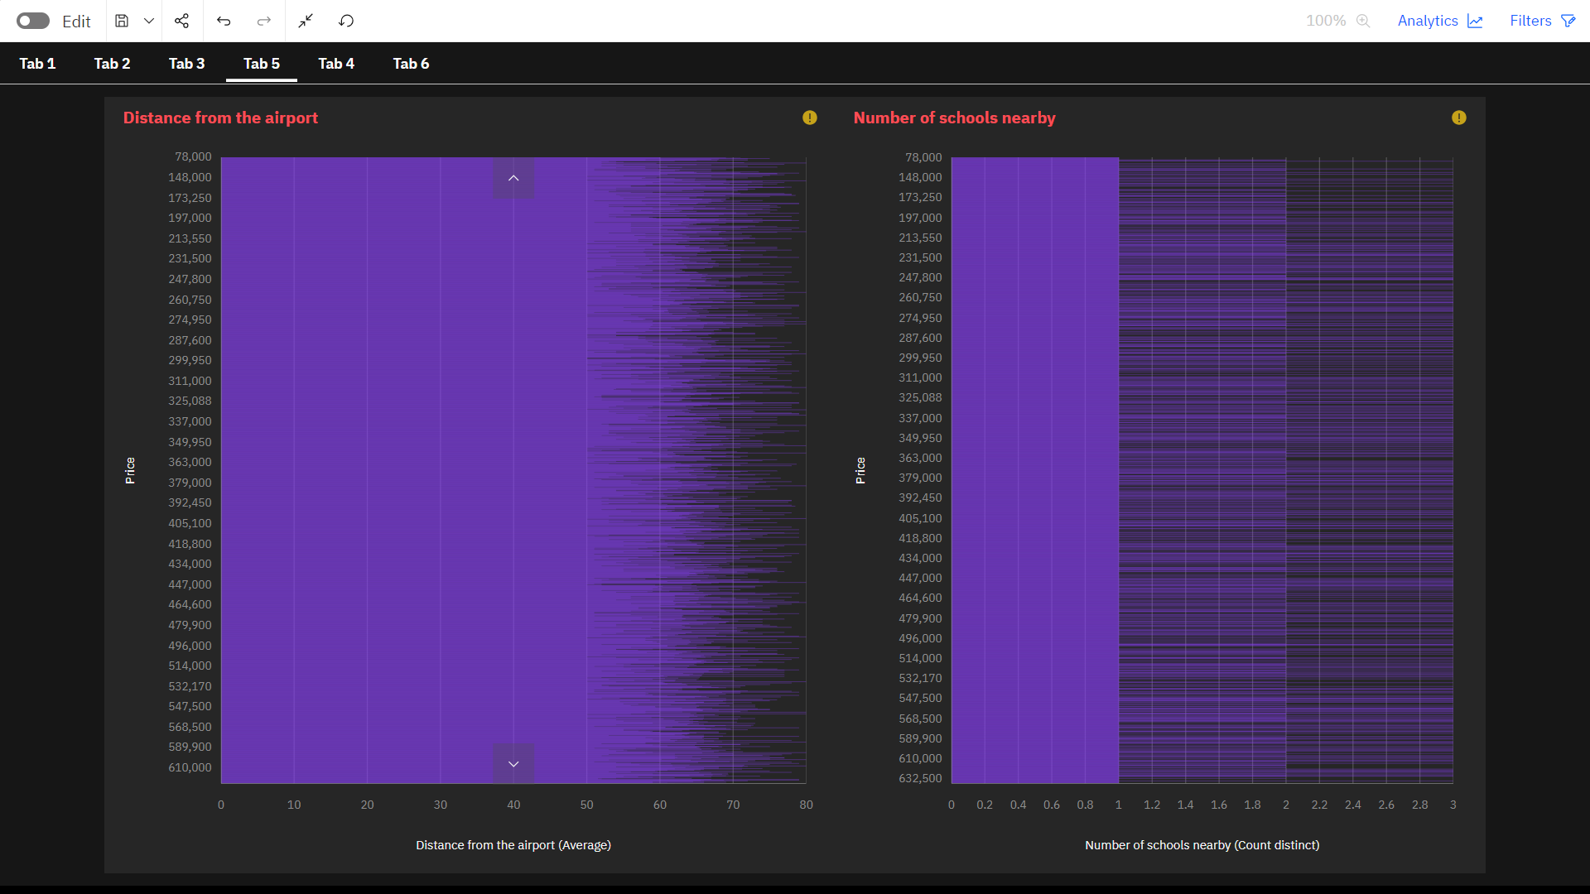
Bi-variate Analysis

Slide 4
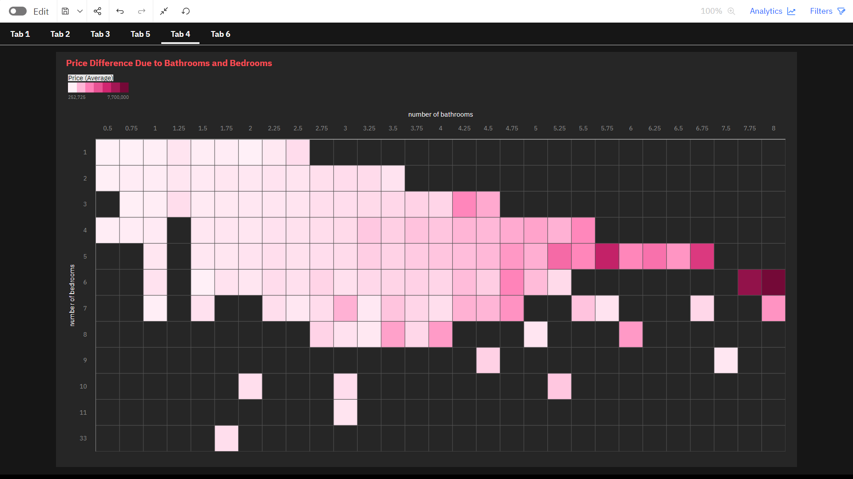
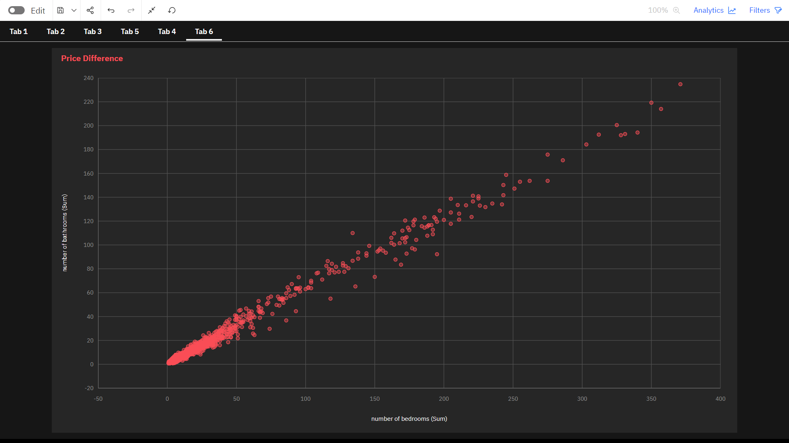
Multi variate Analysis
Multi variate Analysis

Slide 5
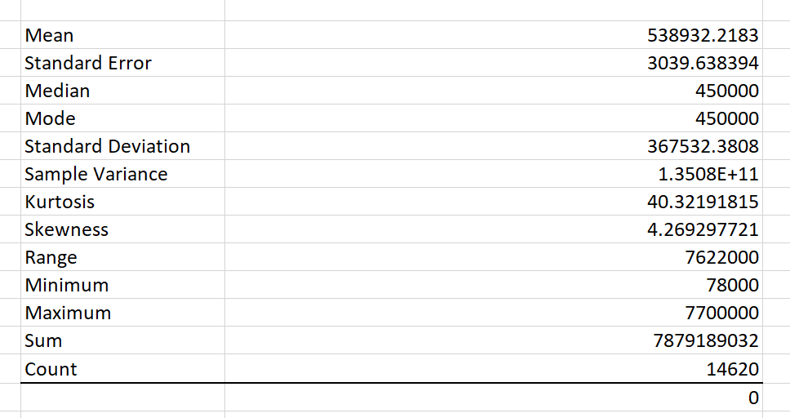
Perform descriptive statistics on the dataset
Handle the Missing values
No Missing values in the Data set.

